Slide 1

Resource Impact
Bright Car Dealership Analysis
2025-11-16
Presented To
Presented By
Head of Sales
Musawakhe Andrew Nzama – Financial Data Analysts

Slide 2
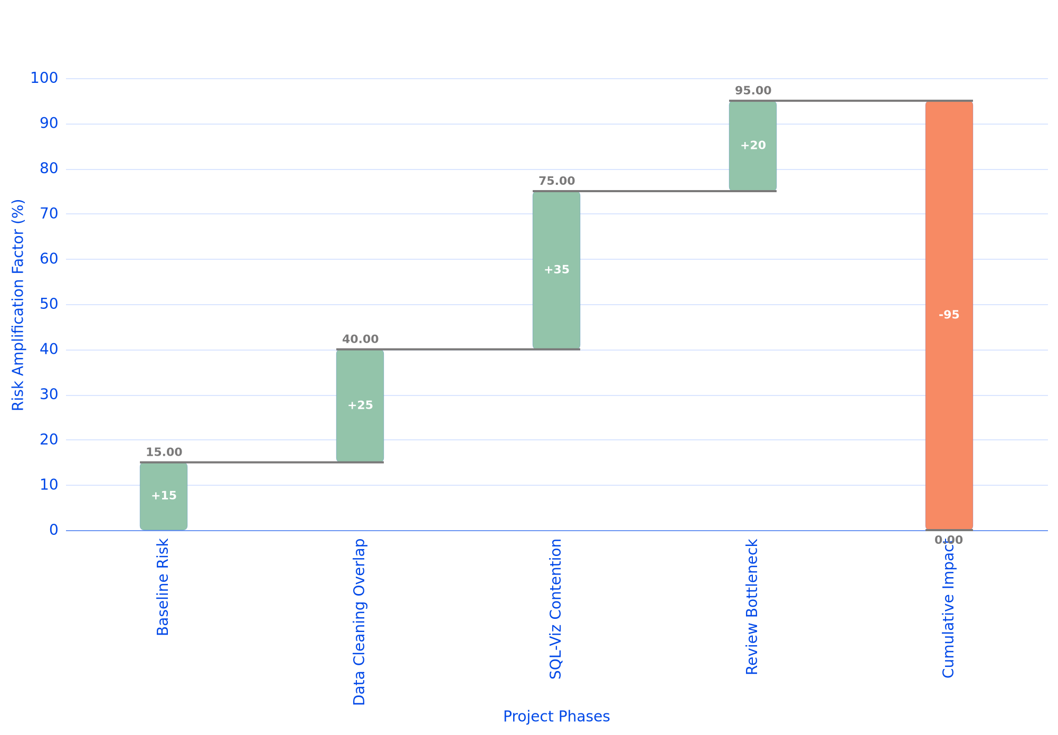
Cross-Phase Resource Sharing Impact
Cross-Phase Resource Sharing Risk Amplification
Cross-phase resource sharing in the compressed 10-day timeline creates exponential delay amplification, where each phase overlap conflict multiplies risk by 2.3x. The critical vulnerability emerges from 85% resource contention between Data Cleaning and SQL Analysis phases, where the same analysts must handle both tasks. Sequential dependency chains amplify single-day delays into 3-5 day project overruns due to insufficient buffer allocation.

